Slide 1

人工智能核心能力培养 — Lecture 08 Recurrent Neural Networks The Kernel Ability For Artificial Intelligence
高民权

Slide 2

Review
Lots of Machine Learnings
Neural Networks and its Principles
Some Pragmatic Neural Networks tips for deep learning

Slide 3
Today
时间序列、文本、依赖问题 Time series, text, dependency problems
循环神经网络的原理 Recurrent Neural Network
改进版的循环神经网络 LSTM, GRU
RNN模型的相关实际用途 Some useful applications of RNNs
RNN模型的一些小问题 Some issues of RNNS

Slide 4
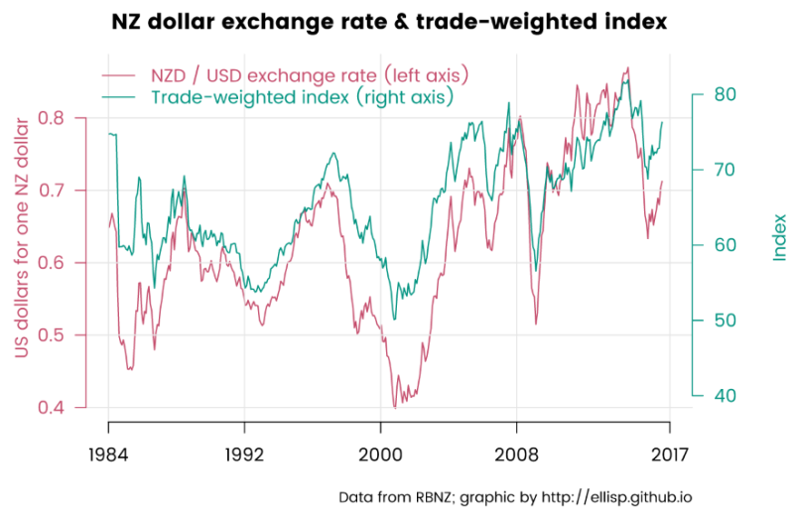

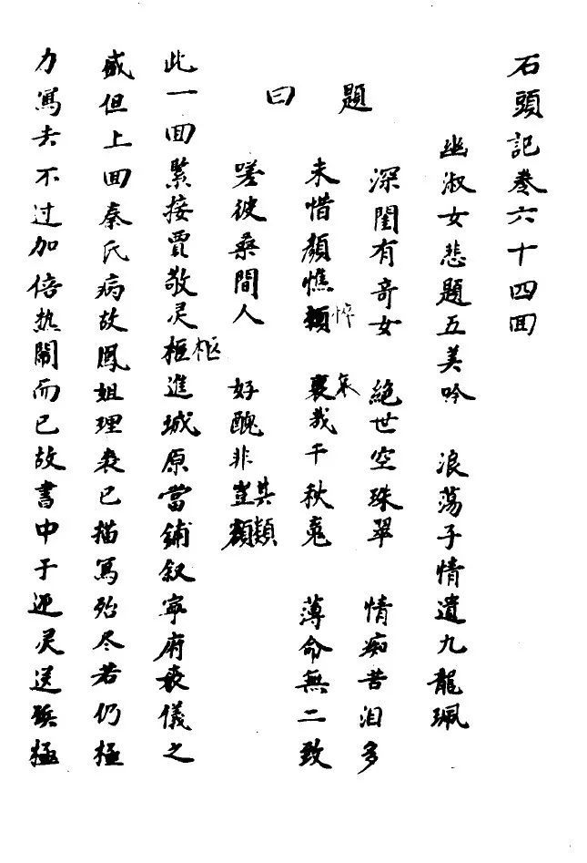
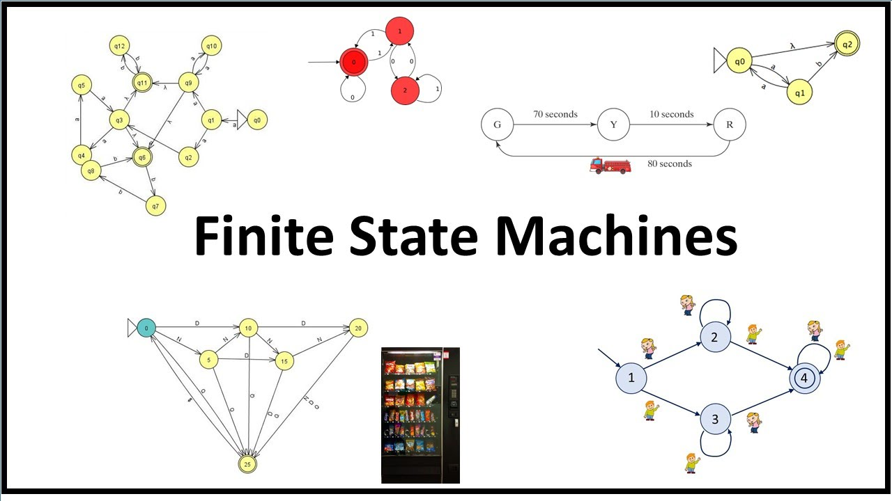

Slide 5
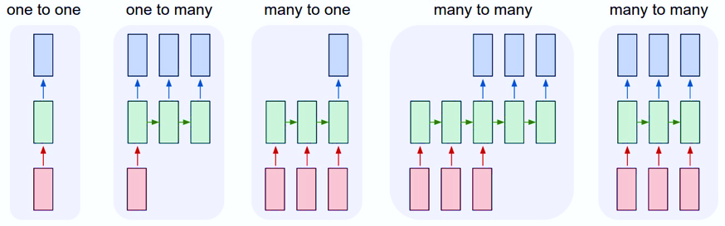
序列问题 Sequence Problems

Slide 6
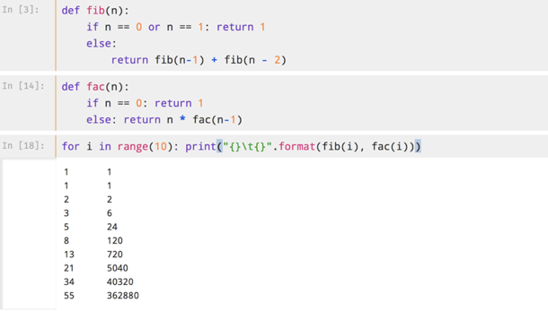
A real example for sequence problem
Using pytorch

Slide 7
Programming -08-01
Sequence problem using linear model
With pytorch

Slide 8
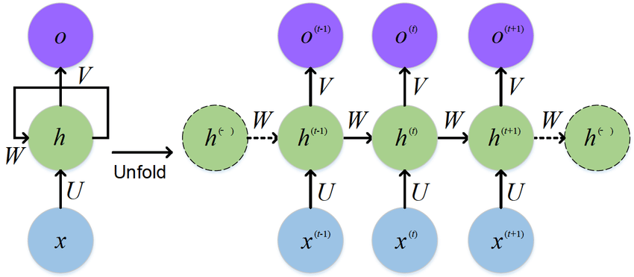

Slide 9

The Dependency in Neural Networks
Previous we tree the neural networks as：
$y_{t}=σ\left(Wx_{t}+b\right)$
$y_{t+1}=σ(Wx_{t+1}+b)$
Now We treat the neural networks as:
Elman network: $h_{t}=σ_{h}\left(W_{h}x_{t}+U_{h}h_{t−1}+b_{h}\right)$
$$y_{t}=σ_{y}(W_{y}h_{t}+b_{y})$$
Or
Jordan networks: $h_{t}=σ_{h}\left(W_{h}x_{t}+U_{h}y_{t−1}+b_{h}\right)$
$$y_{t}=σ_{y}(W_{y}h_{t}+b_{y})$$

Slide 10
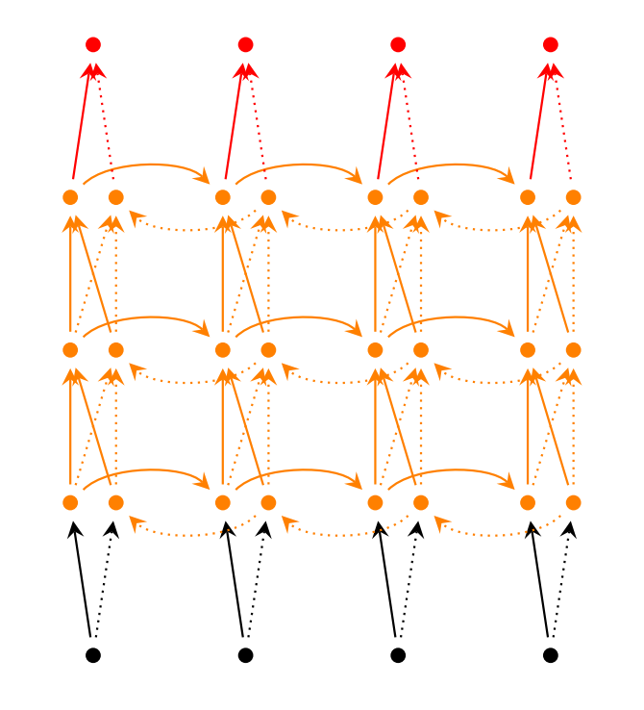
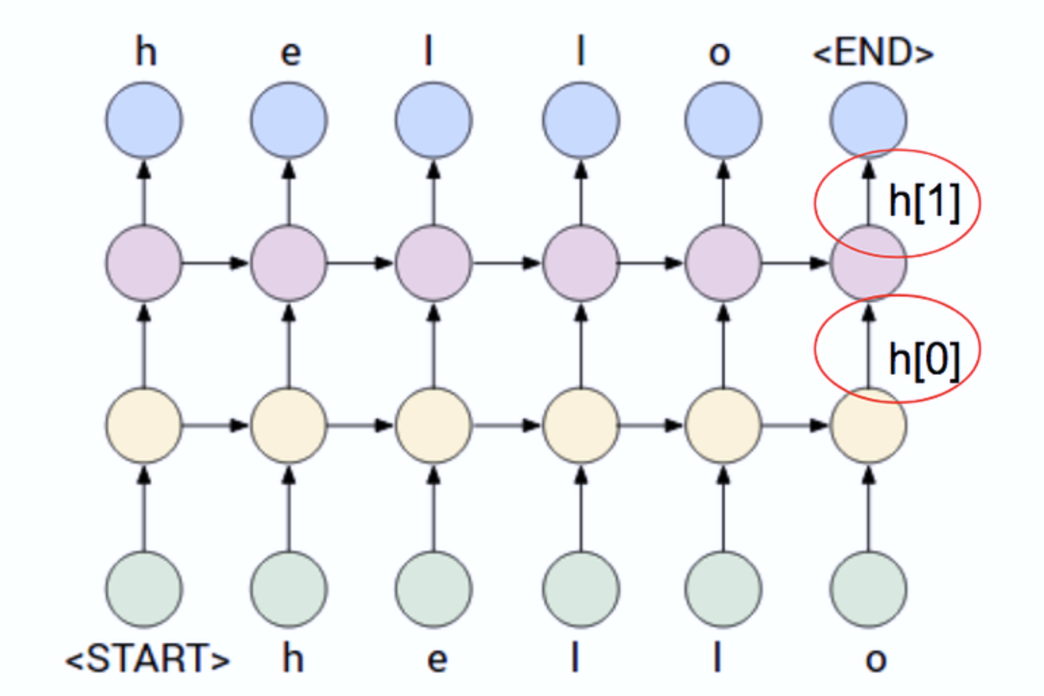
Stacked RNN
Bidirectional RNN

Slide 11
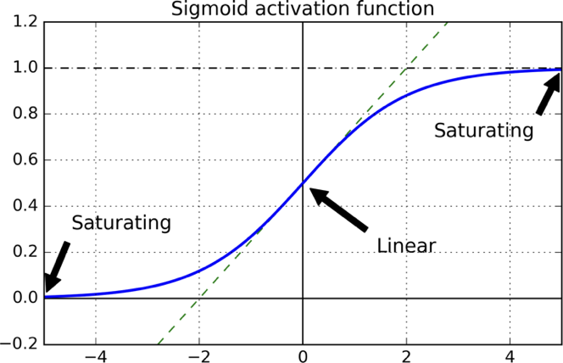
The Challenge of Long-Term Dependencies
Vanishing, Exploding Problem
climb mountains

Slide 12
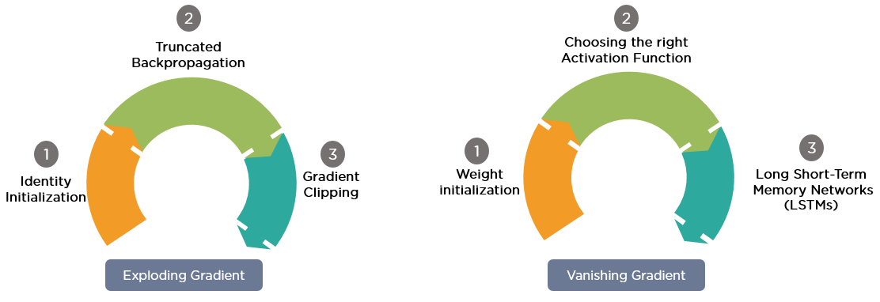
Gradient Vanshing & Gradient Exploding

Slide 13


Long-term memory

Slide 14
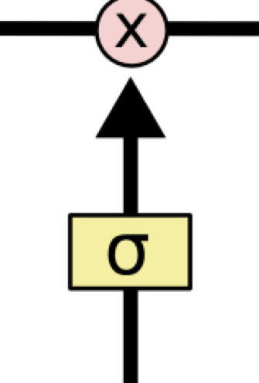
LSTM
L-Long S-Short T-Term M-Memory
Gate: Information Control
converge faster
detect long-term dependencies
Gates are a way to optionally let information through. They are composed out of sigmoid neural net layer and a pointwise multiplication operation.
Q: Why sigmoid?

Slide 15
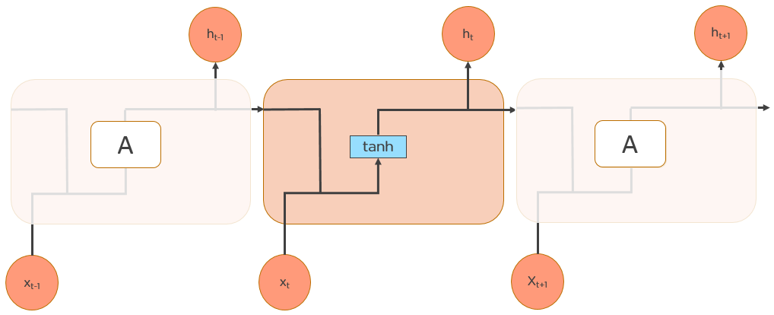
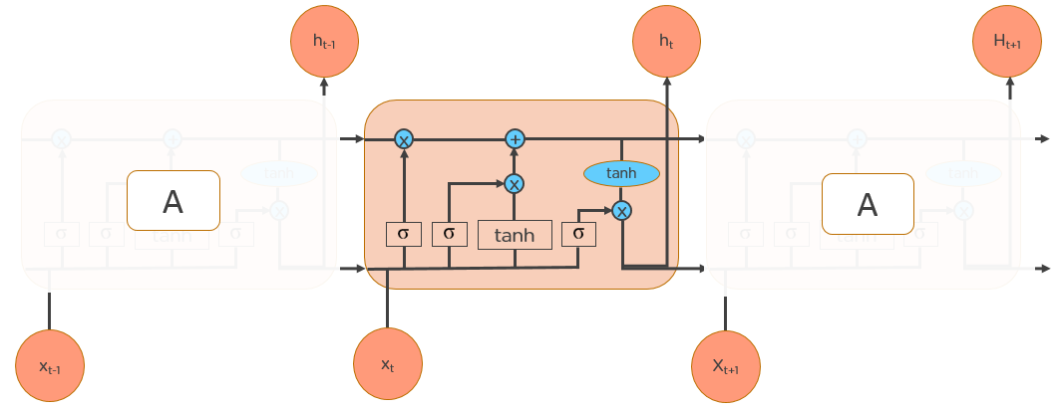

Slide 16
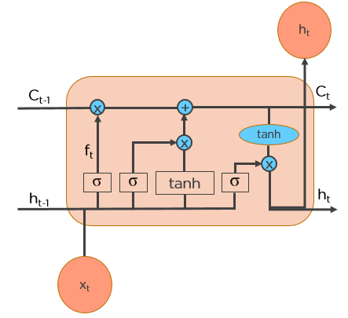
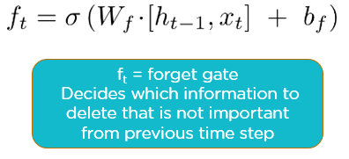
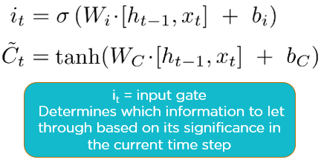
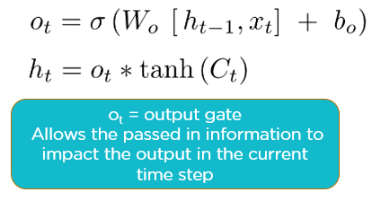
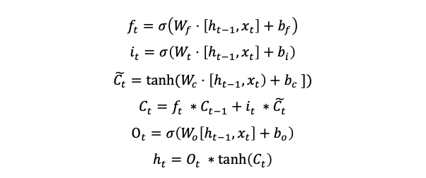
$$f_{t}=σ\left(W_{f}⋅\left[h_{t−1}, x_{t}\right]+b_{f}\right)$$
$$i_{t}=σ\left(W_{t}⋅\left[h_{t−1}, x_{t}\right]+b_{i}\right)$$
$$\tilde{C_{t}}=tanh⁡(W_{c}⋅\left[h_{t−1}, x_{t}\right)+b_{c} ])$$
$$C_{t}=f_{t} ∗C_{t−1}+i_{t} ∗\tilde{C_{t}}$$
$$O_{t}=σ\left(W_{o}\left[h_{t−1}, x_{t}\right]+b_{o}\right)$$
$$h_{t}=O_{t} ∗\tanh\left(C_{t}\right)$$
Step-01: Decide how much past data it should remember
Step-02: Decide how much this unit adds to the current
state
Step-02: Decide what part of the current cell state makes it to the output

Slide 17
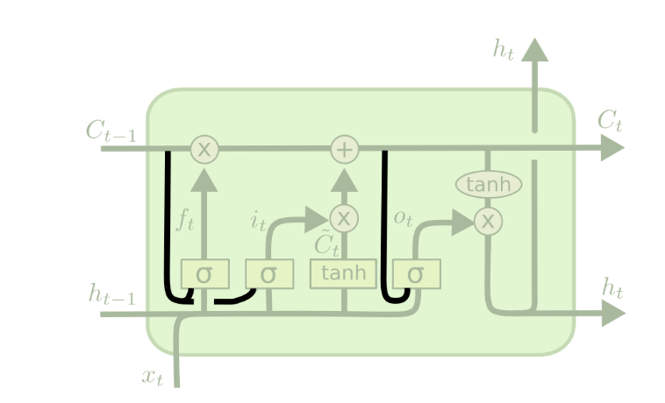
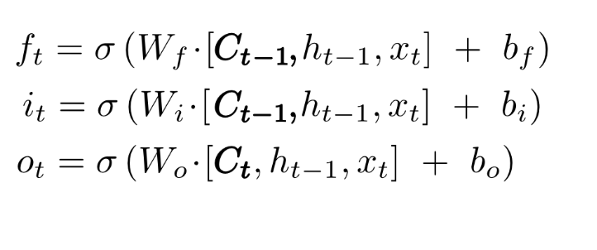
Peephole connection We let the gate layers look at the cell state

Slide 18
GRU: Gated Recurrent Unit
Simpler and fewer parameters!
http://arxiv.org/pdf/1406.1078v3.pdf

Slide 19
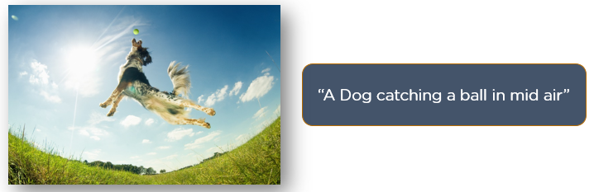
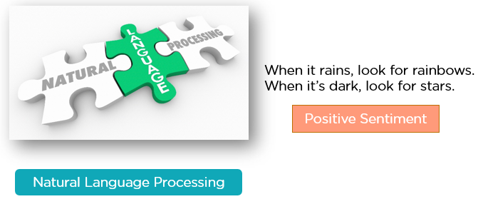
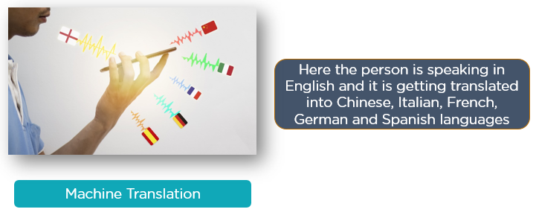
RNN模型的应用 RNN applications
Prediction problems
Language Modelling and Generating Text
Machine Translation
Speech Recognition
Generating Image Descriptions
Video Tagging
Text Summarization
Call Center Analysis
Music composition

